Slide 1
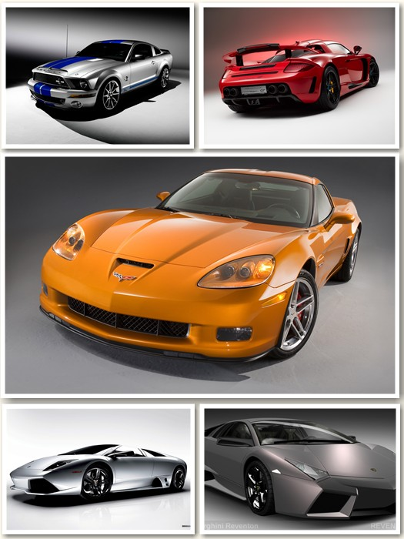
Analyzing and Predicting Car Prices in the Australian Market
CSIS 3360
Carlos Sibaja
John Zapana
Esta foto de Autor desconocido está bajo licencia CC BY-SA-NC

Slide 2
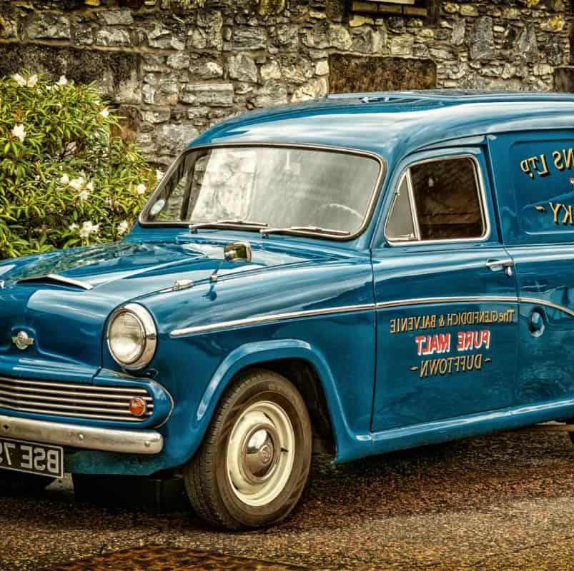
TABLE OF CONTENT
METER LA TABLA
APPENDIXES

Slide 3
INTRODUCTION
PROJECT GOALS AND OBJECTIVES
PREDICT SALE PRICES OF HOUSES IN SEATTLE USA USING HISTORICAL DATA

Slide 4


DATA SET
SOURCE
Kaggle https://www.kaggle.com/datasets/vikramamin/kc-house-dataset-home-prices
INFORMATION
The data set contains information about house sales in SEATTLE,USA
between
May 02 2014 and May 27 2015

Slide 5
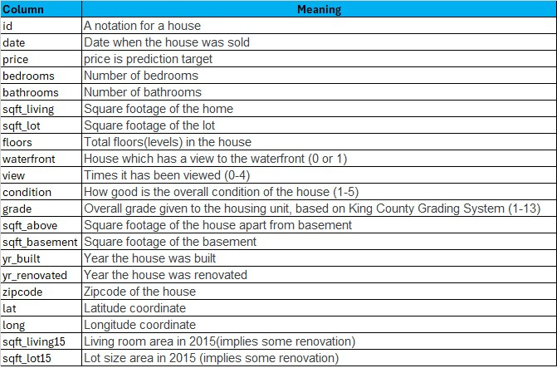
DATA SET
The data set contains 21 columns and 21613 rows

Slide 6



DATA PREPARATION
IDENTIFIED AND DELETE SOME OUTLIERS
1 house with 33 bedrooms
3 rows with null values
10 houses with no bathroom

Slide 7
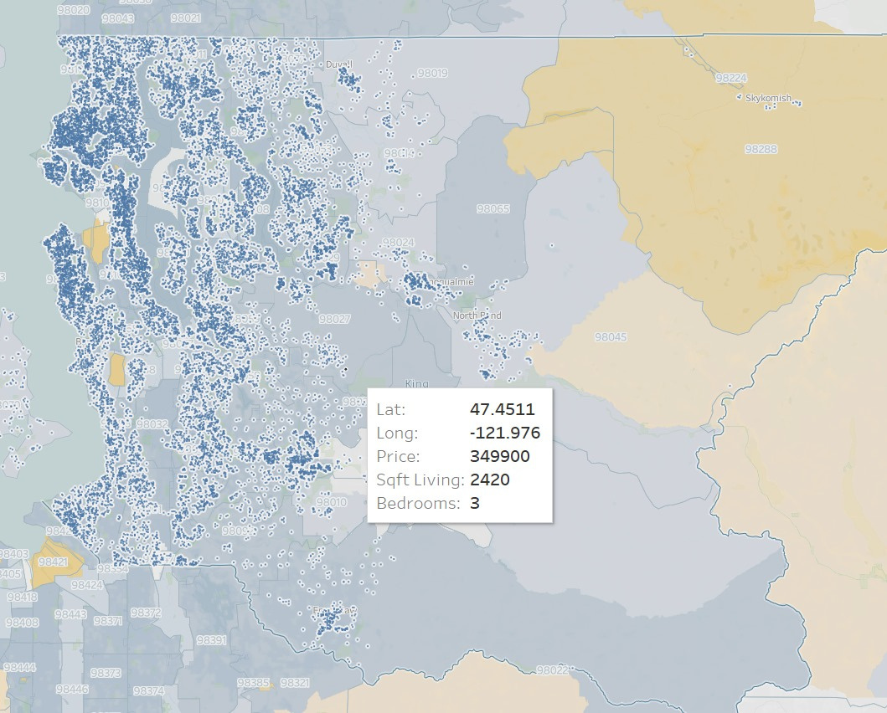
DATA VISUALIZATION
Map of House in Seattle

Slide 8
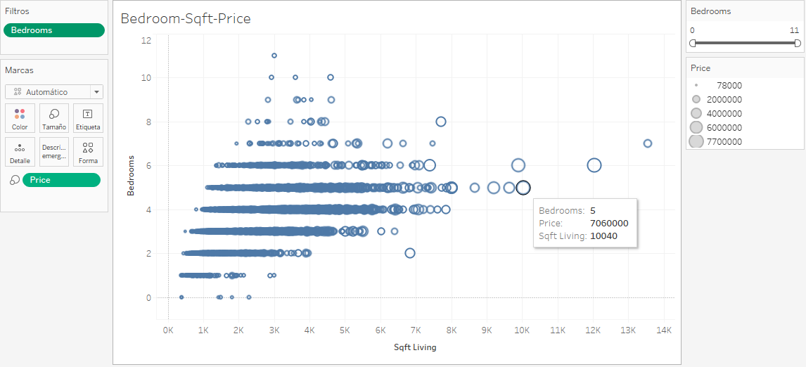
DATA VISUALIZATION
Houses showing bedrooms, price and Sqft-living

Slide 9

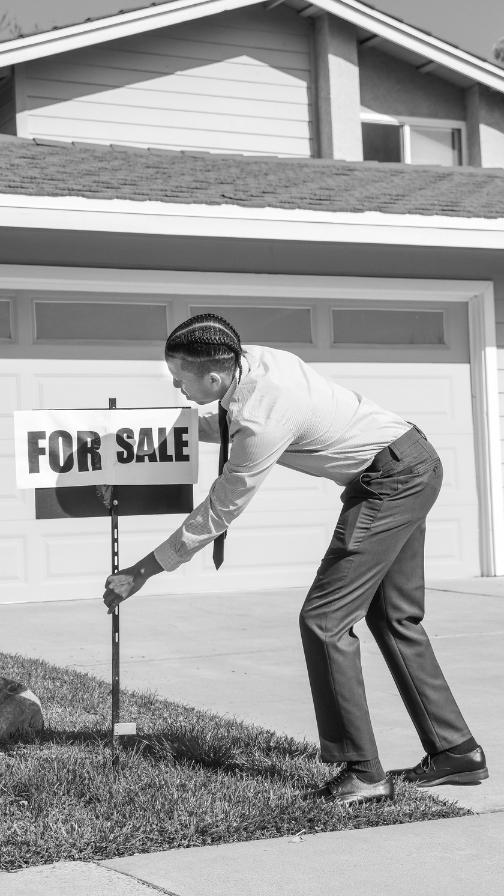

PREDICTIVE MODELS USED
LINEAR REGRESSION
XG BOOST
RANDOM FOREST

Slide 10
PREDICTIVE MODELS USED
Objective:
Predict house prices using various features
Key Features Analyzed:
Bedrooms, bathrooms, sqft_living, sqft_lot, floors, waterfront, view, condition, grade, sqft_above, sqft_basement, yr_built, yr_renovated, zipcode, lat, long, sqft_living15, sqft_lot15.
(Did not drop any column)
LINEAR REGRESSION

Slide 11
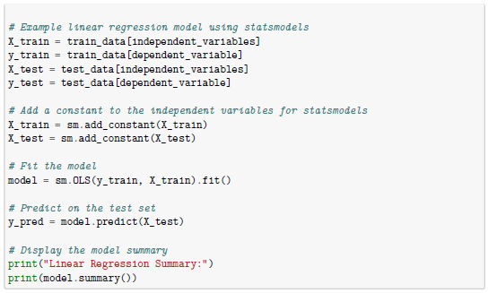
LINEAR REGRESSION
Program in Python to do linear regression.
PREDICTIVE MODELS USED

Slide 12
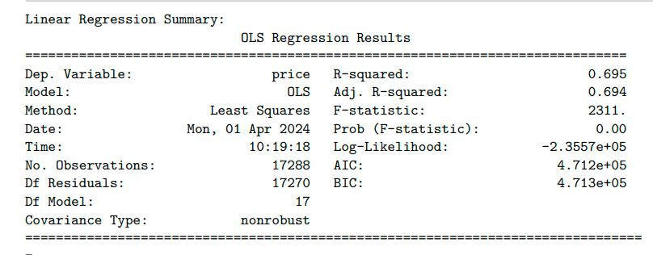
LINEAR REGRESSION
R-squared: 0.695
Average Percentage Error: 25.77%
PREDICTIVE MODELS USED

Slide 13
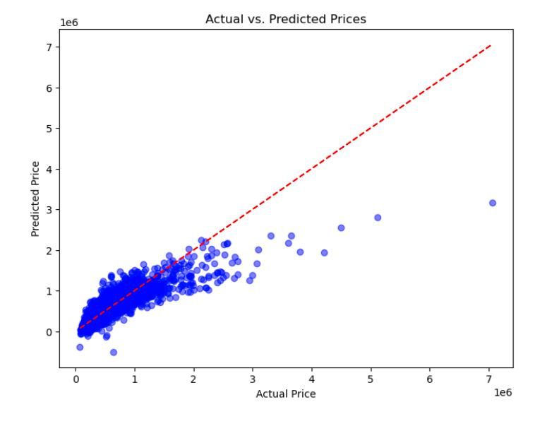
LINEAR REGRESSION
PREDICTIVE MODELS USED

Slide 14
PREDICTIVE MODELS USED
XGBoost stands for eXtreme Gradient Boosting. It is a highly efficient and scalable implementation of gradient boosting, a machine-learning technique used for regression.
The main advantage of XGBoost over Linear Regression lies in its ability to handle non-linear relationships between features and the target variable
XG BOOST

Slide 15
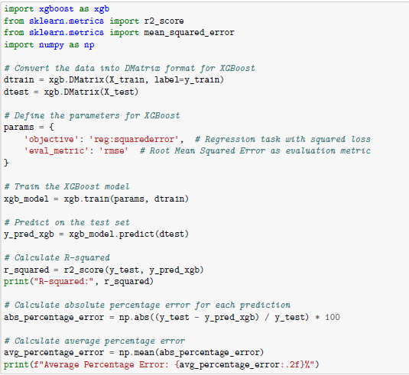
XG Boost
R-squared: 0.849
Average Percentage Error: 15.13%
PREDICTIVE MODELS USED

Slide 16
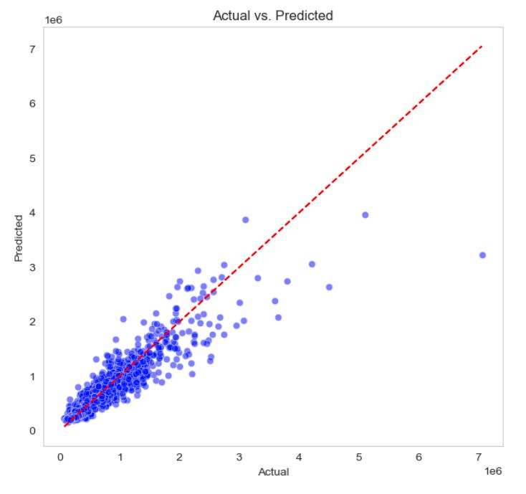
XG BOOST
PREDICTIVE MODELS USED

Slide 17
PREDICTIVE MODELS USED
RANDOM FOREST
Random forest is a machine learning technique that builds on the simplicity of decision trees and improves their predictive performance by combining the results of several trees to form a "forest". It works by constructing numerous decision trees at training time and outputs the mode of the classes (for classification tasks) or the mean prediction (for regression tasks) of the individual trees.

Slide 18
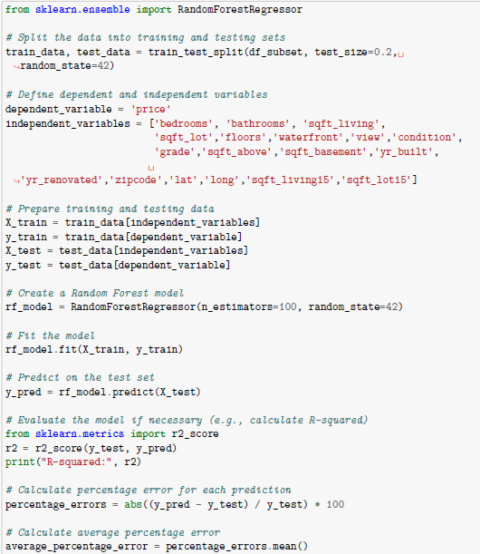
RANDOM FOREST
R-squared: 0.876
Average Percentage Error: 15.13%
PREDICTIVE MODELS USED

Slide 19
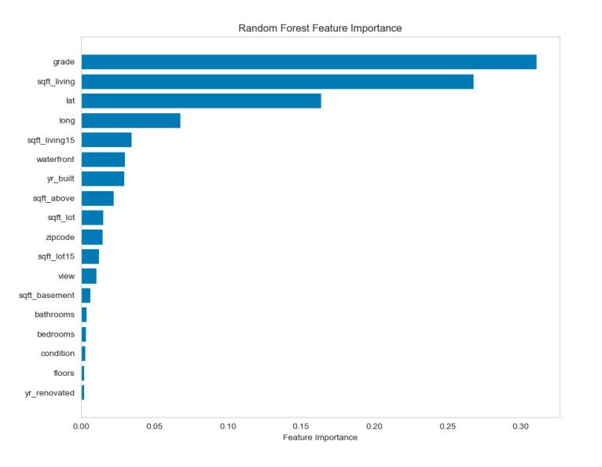
RANDOM FOREST
PREDICTIVE MODELS USED

Slide 20
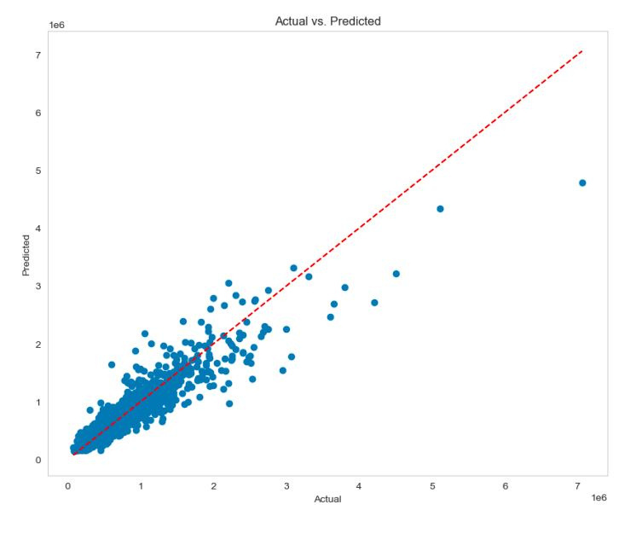
RANDOM FOREST
PREDICTIVE MODELS USED

Slide 21
CLASSIFICATION MODEL USED
CLUSTERING

Slide 22
CLASSIFICATION MODEL USED
CLUSTERING
Clustering is a technique used in unsupervised machine learning that involves grouping a set of objects in such a way that objects in the same group (called a cluster) are more similar (in some sense) to each other than to those in other groups

Slide 23
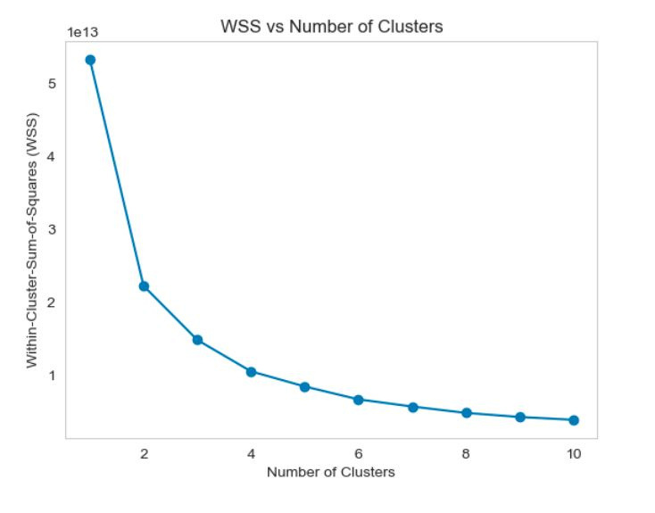
CLUSTERING
CLASSIFICATION MODEL USED

Slide 24
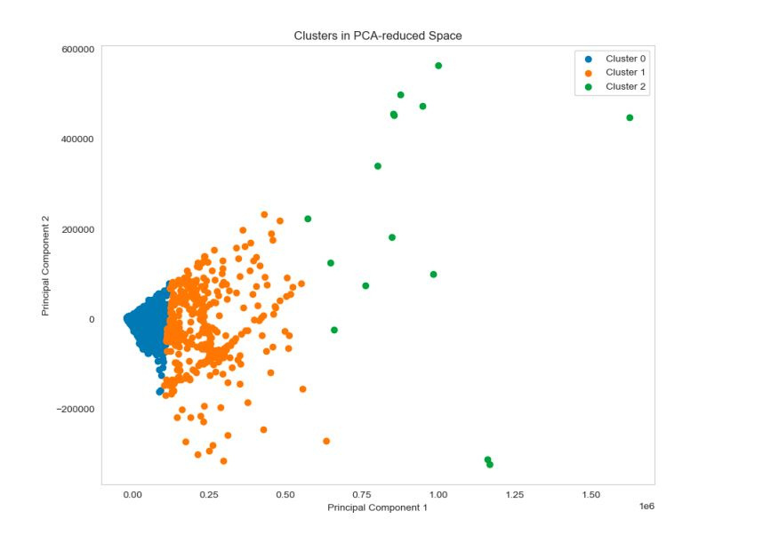
CLUSTERING
CLASSIFICATION MODEL USED

Slide 25
SUMMARY
This report presents the power of machine learning to predict and analyze housing prices.
Employing a linear regression model, we discovered a significant relationship between housing characteristics and housing price, achieving an adjusted R-squared value of 0.694.
Moving to a more sophisticated approach, the use of XGBoost not only improved the predictive ability, but also highlighted the superior performance of the model, with an R-squared value of 0.849, and significantly reducing the average error rate to 15.13%.

Slide 26
SUMMARY
Subsequently, a random forest model was used, which further refined the predictions, reaching an R-squared value of 0.876.
Finally, the exploration of the clusters presented the underlying structure of the data, revealing distinct groupings within the housing market.

Slide 27
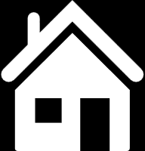
THANK YOU

